Slide 1

Trout in the Classroom
Fish Health Workshop
2015
Coja Yamashita
Fish Health Unit Leader

Slide 2

Agency Organization
Executive Director
Office of Field Operations
Bureau of Hatcheries
Division of Fish Production Services

Slide 3
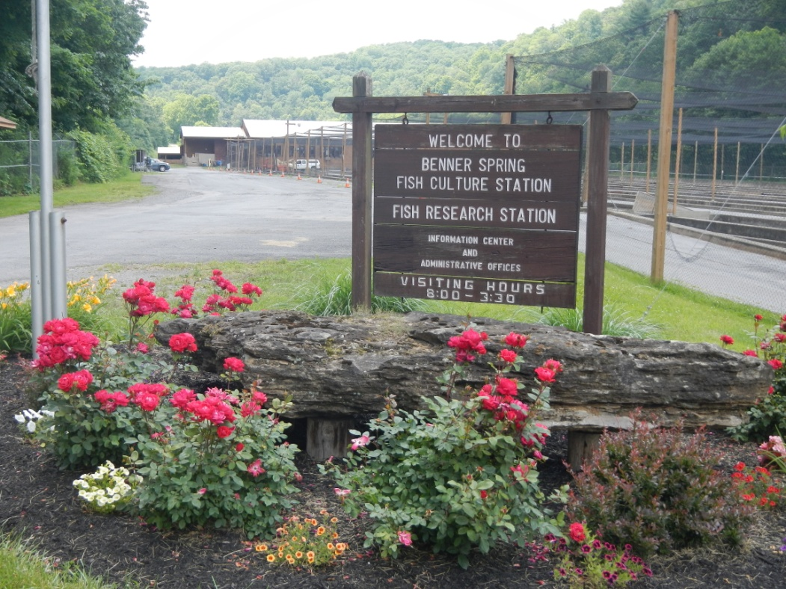
Fish Production Services
Provide technical services to the hatchery system
Conduct research related to Aquaculture
Assist other Bureaus and Divisions as needed

Slide 4
Fish Production Services
Anadromous Fish Restoration Unit
Water Quality Unit
Cooperative Nursery Unit
Fish Health Unit

Slide 5
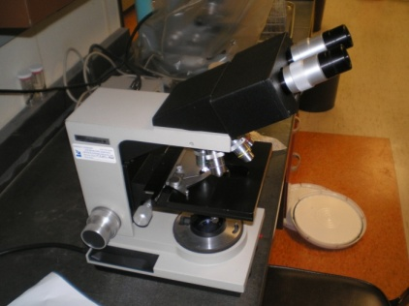
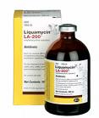
Fish Health Unit
Provide Diagnostic services to the hatchery system
Drug and Chemical purchasing / distribution and FDA compliance
Fish Health Monitoring
  Annual Hatchery Inspections
  Monitoring of Wild Brood stocks

Slide 6
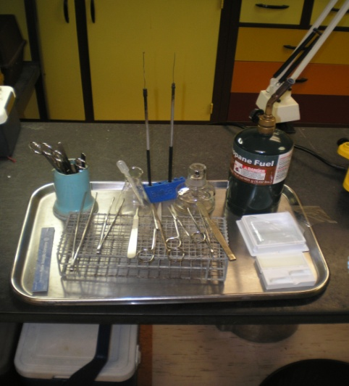
Fish Health Unit
Disease prevention programs
  Vaccinations
  Brood treatments
Wild fish kill investigation
Instruction/training

Slide 7
Fish Health
What causes disease
Signs of disease
Common Diseases
Disease prevention

Slide 8



What causes a disease event
Host
Pathogen
Environment

Slide 9
Types of Disease
Non Infectious
Environment
+
Host
Infectious Disease
Environment
+
Host
+
Pathogen

Slide 10
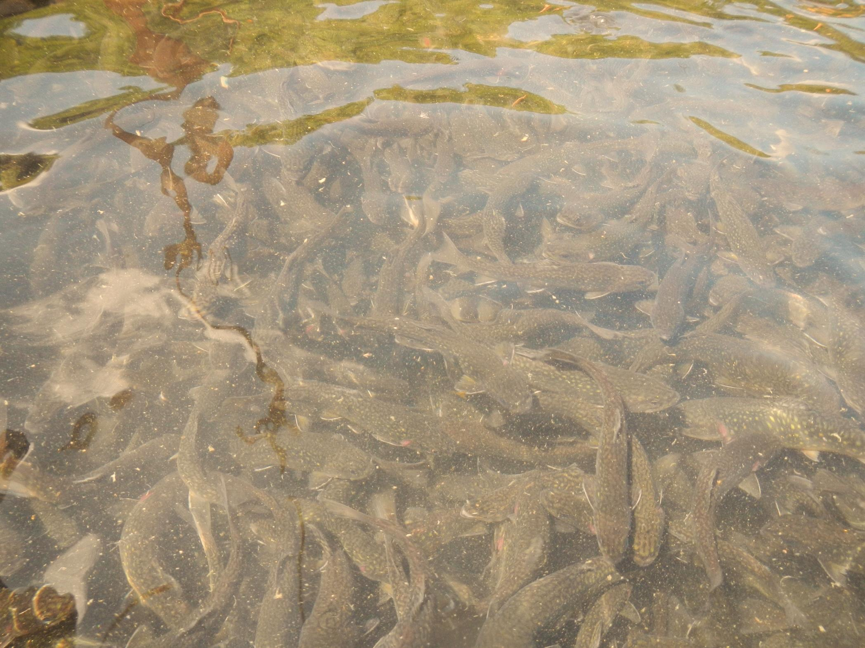
Host
Brook Trout
(Salvelinus fontinalis)

Slide 11
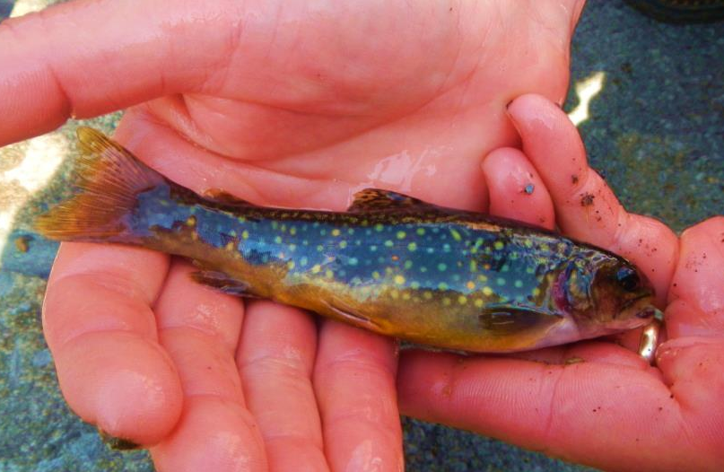
Host Factors
Fish Species
Fish Strain
Age or Life stage

Slide 12
Fish Species
  Brook Trout
Highly Susceptible to Furunculous (Bacterial Pathogen)
Highly Susceptible IPNv (Viral Pathogen)
Highly Susceptible BKD (Bacterial pathogen)
Less susceptible to Whirling Disease (Parasite)
Can withstand lower pH
Low Temperature range

Slide 13
Fish Strain
(Genetics)
Some strains of fish have become more or less resistant to specific pathogens
Can help with increase the survival of fish within a hatchery and in the wild
Fish can act as carriers introducing disease to wild populations.

Slide 14
Age
Fish are more susceptible to specific diseases at different ages or life stage
External parasites have a greater effect on small fish
  Fry > small fingerling>adults
Viruses and Bacterial disease can effect specific Life stages
  IPNv – fry/small fingerling - Brook Trout
Environmental conditions affect life stages differently
  Gas Bubble Disease – Fry
  Dissolved Oxygen – Larger Fish

Slide 15
Types of Disease
Non Infectious
Host
+
Environment
Infectious Disease
Host
+
Environment
+
Pathogen

Slide 16
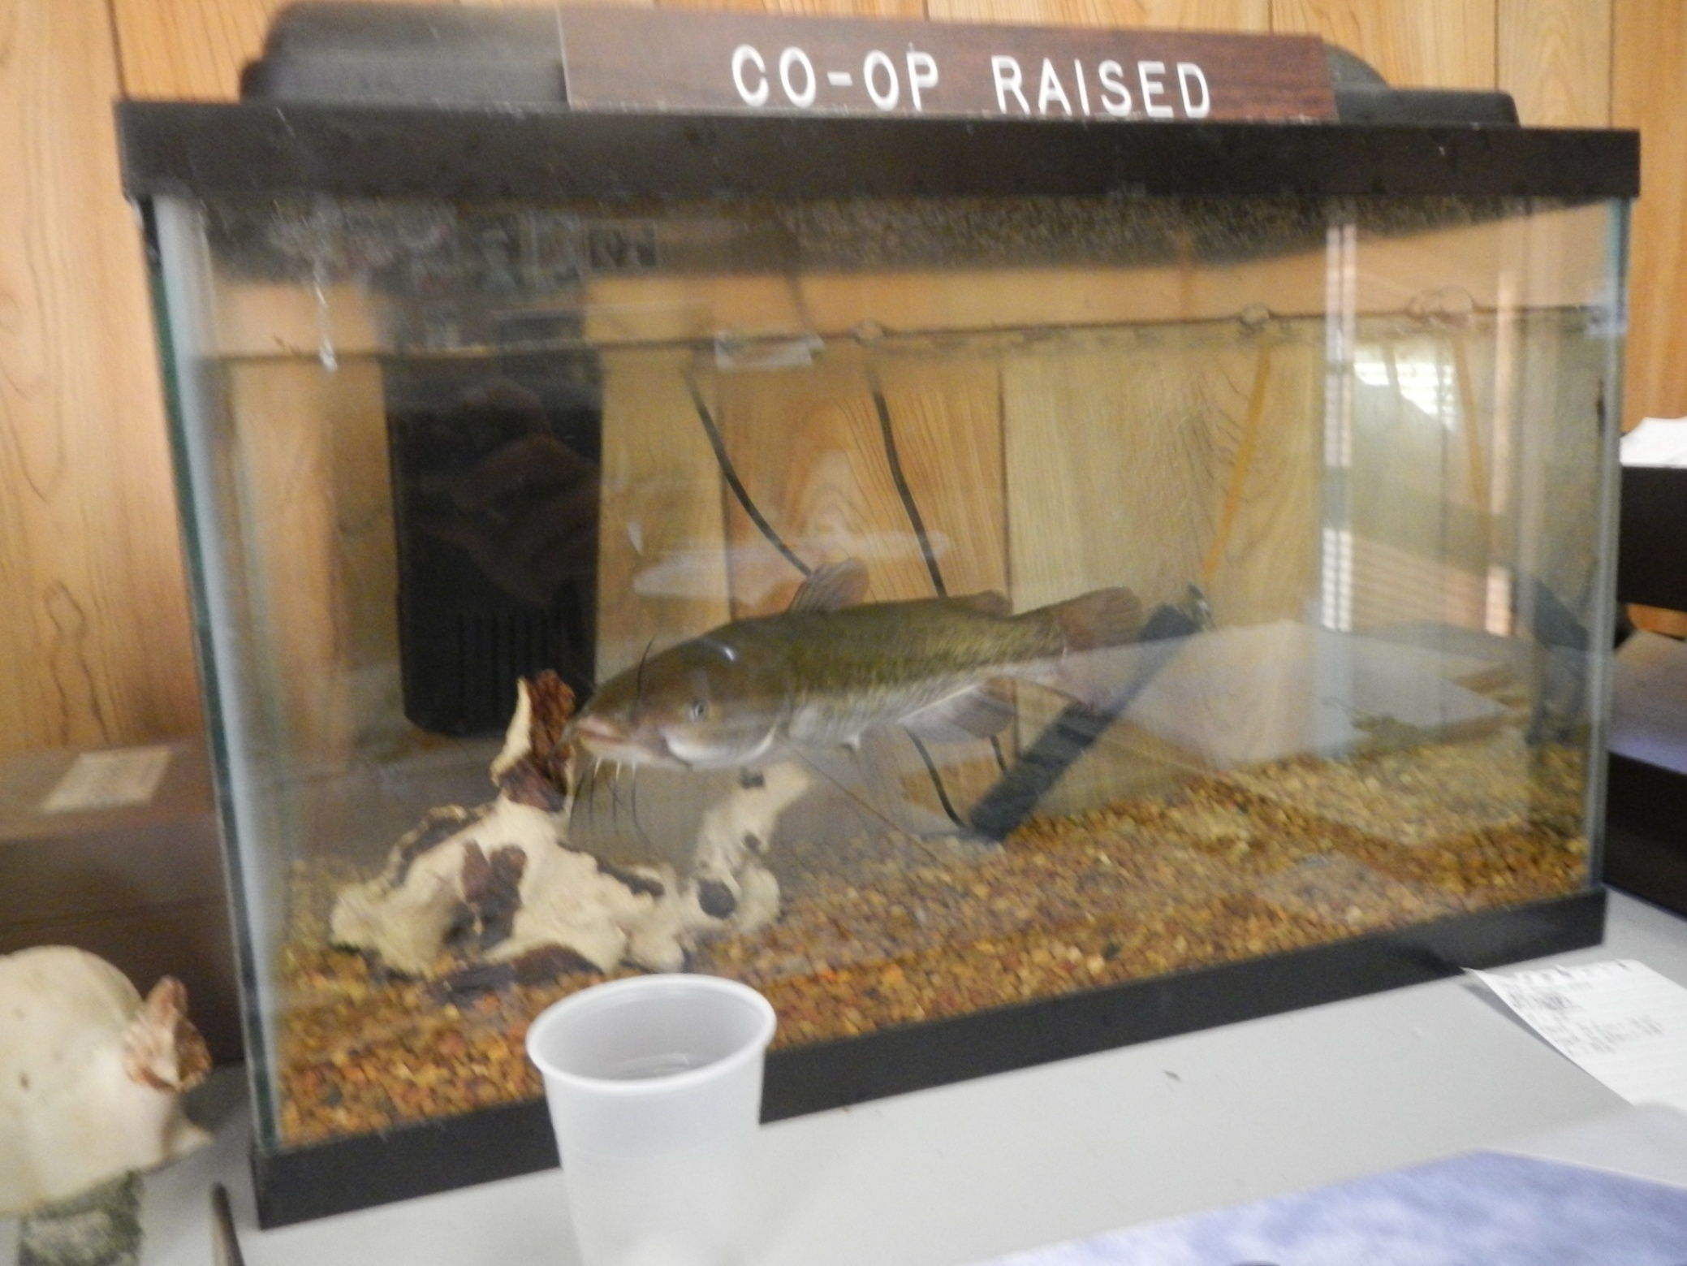
Environment

Slide 17
Environment
Directly responsible for significant mortality
(Non Infectious Disease)
or
Act as a stressor making fish more susceptible to Infectious Disease
In a closed system the environmental conditions can be easily monitored and manipulated.

Slide 18
Environmental Factors
Water Quality
Nutrition
Mechanical
Population Density
Physical Environment

Slide 19
Water Quality
Water Quality usually plays a role in both infectious and non infectious disease
There are specific ranges within each parameter that fish can survive
High or Low ends of each range can cause chronic stress
  Effect growth rate
  Cause immune system suppression increasing susceptibility and response to infectious disease
Rapid changes in any Water Quality parameter (Temp, pH,) can cause stress and mortality.
  Fish should be tempered when changing water
  Water Quality is often a major component in the “perfect storm” that leads to major mortality events.

Slide 20

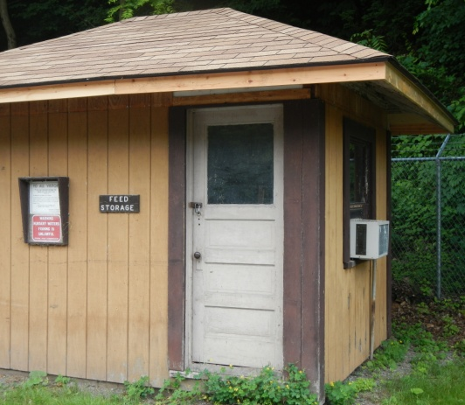
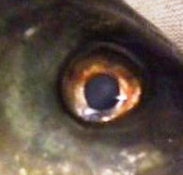
Nutrition
Poor nutrition can act as a stressor, making fish more susceptible to other environmental conditions or infectious diseases.
Food Size
  Need to feed to the smallest fish in the tank.
Nutritional requirements
  Specific feeding rates (ex - 3% Biomass)
  Protein, fat, Fiber
Storage
  Feed can become rancid or moldy
  Food should be stored in cool/dry/dark conditions
  Do not use old feed, start fish off on new feed each year.

Slide 21
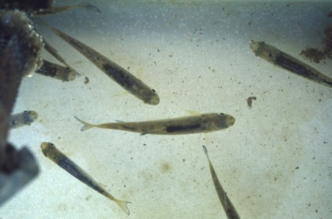
Physical Environment
Current
  Fit Fish = Healthy fish
  Disperse Food/Nutrients/Toxins/Dissolved Oxygen
  Make sure current is not creating dead spots
Cover/shade/structure
  Provides a more natural environment
  Lack of structure can increase stress
High Traffic Areas
  Fish will react to movement

Slide 22
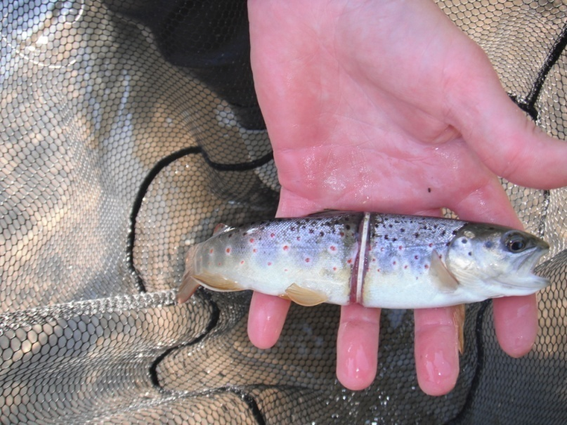
Mechanical
(Pumps, Filters, Air stones, lights, Chillers )
Usually act as a stressor but can also cause mortality
Noise / Vibration
  Avoid direct contact of equipment with tank
Electricity
Light – (intensity, frequency and duration)
  Avoid turning on lights suddenly
  Use Dimmer switches and timers
  Leave blinds open
Impact –(Blunt Force Trauma)

Slide 23
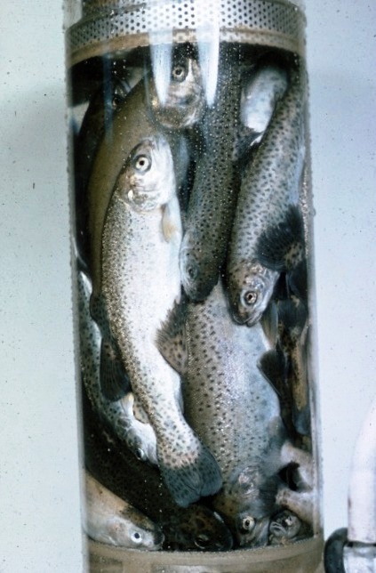
Population Density
Fish Compete for resources
  O2, Food, Space
As fish Grow they require more resources
  Produce more waste leading to a decrease in waterquality, adding stress and compromising their immune system.
Physical Contact (Confrontational and accidental)
  Leads abrasions providing an entry for pathogens.
Monitor water quality
Remove fish if there are to many in the tank, releasing a couple earlier is better than losing them all to disease

Slide 24
Types of Disease
Non Infectious
Host
+
Environment
Infectious Disease
Host
+
Environment
+
Pathogen

Slide 25
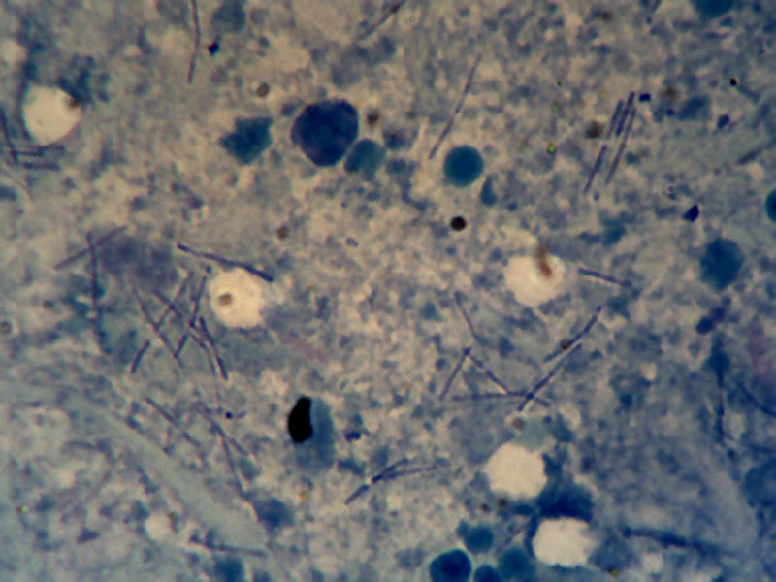
Pathogen

Slide 26
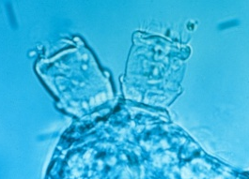
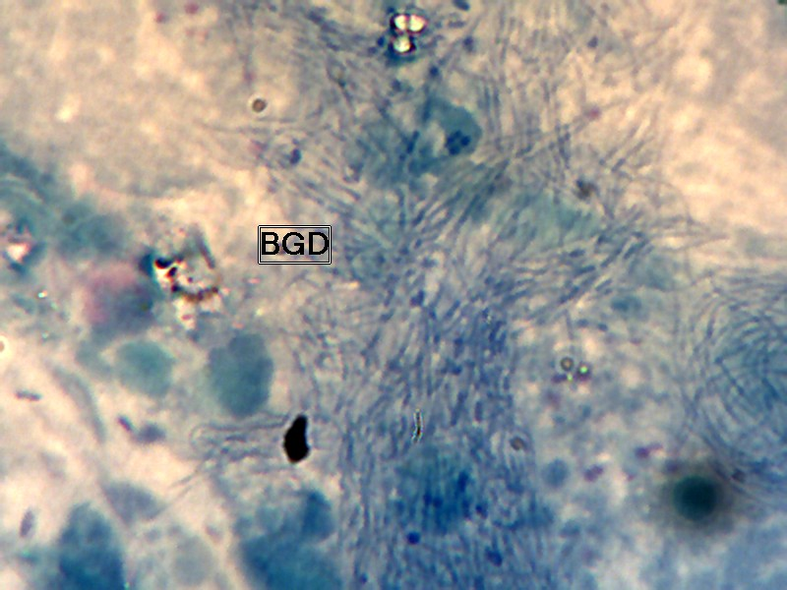
Pathogens
Parasites
Bacteria
Viruses

Slide 27
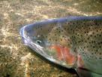

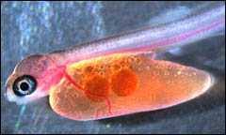
Vertical Transmission
Carried in the egg or on milt during spawning, certain viral and bacterial pathogens can be spread from brood fish to their progeny

Slide 28
Horizontal Transmission
Carried in water or by direct contact, viral and bacterial pathogens can be spread from fish to fish, through bodily fluids, physical contact and eating other fish

Slide 29
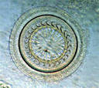
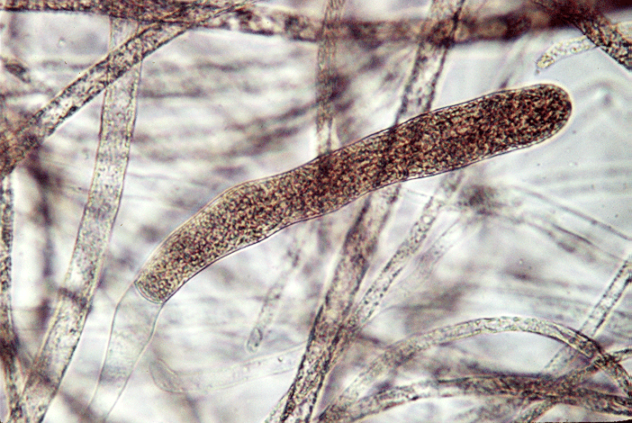
Parasites
Protozoans, Trematodes, Myxozoans, Fungus
Usually transmitted horizontally.
Most parasites do not cause mortality in low numbers but can act as stressors, responsible for high mortality when found in high numbers.
Greater affect on smaller fish.
Some parasites have complex life cycles involving several host.
Presence of high numbers of parasites is usually an indicator of poor water quality or stressed fish.

Slide 30
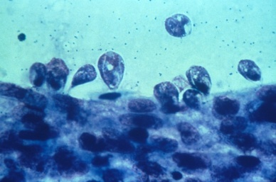
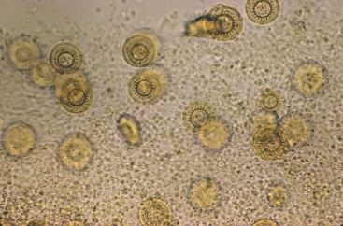
Parasites
Usually diagnosed using a microscope
Fish will flash or rub on the bottom
If parasite is on the gills fish will sometimes cough or have flared gills
Frayed fins are sometimes observed.
Most TIC systems should not be affected by parasites.

Slide 31
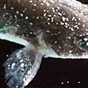

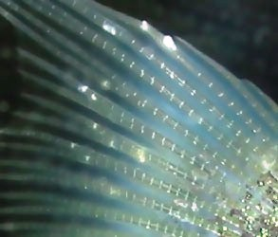
Ichthyophthirius Multifilis
(Ich)
Major mortality in PFBC and world-wide
Horizontal transmission
Largest protozoan fish pathogen
  Adults can be seen with the naked eye
Adult fish will often jump and flash when infestation occurs

Slide 32
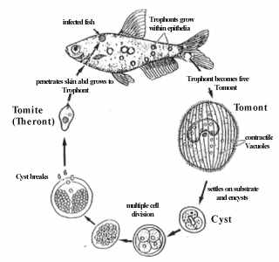
Ich
Complex life cycle
The Tomite or theront is most susceptible to treatment
One tomont can =10,000 tomites
Length of cycle depends on temperature
  3-6 days @ 77° F
  10 days @ 59° F
  30+ days @ 50° F

Slide 33
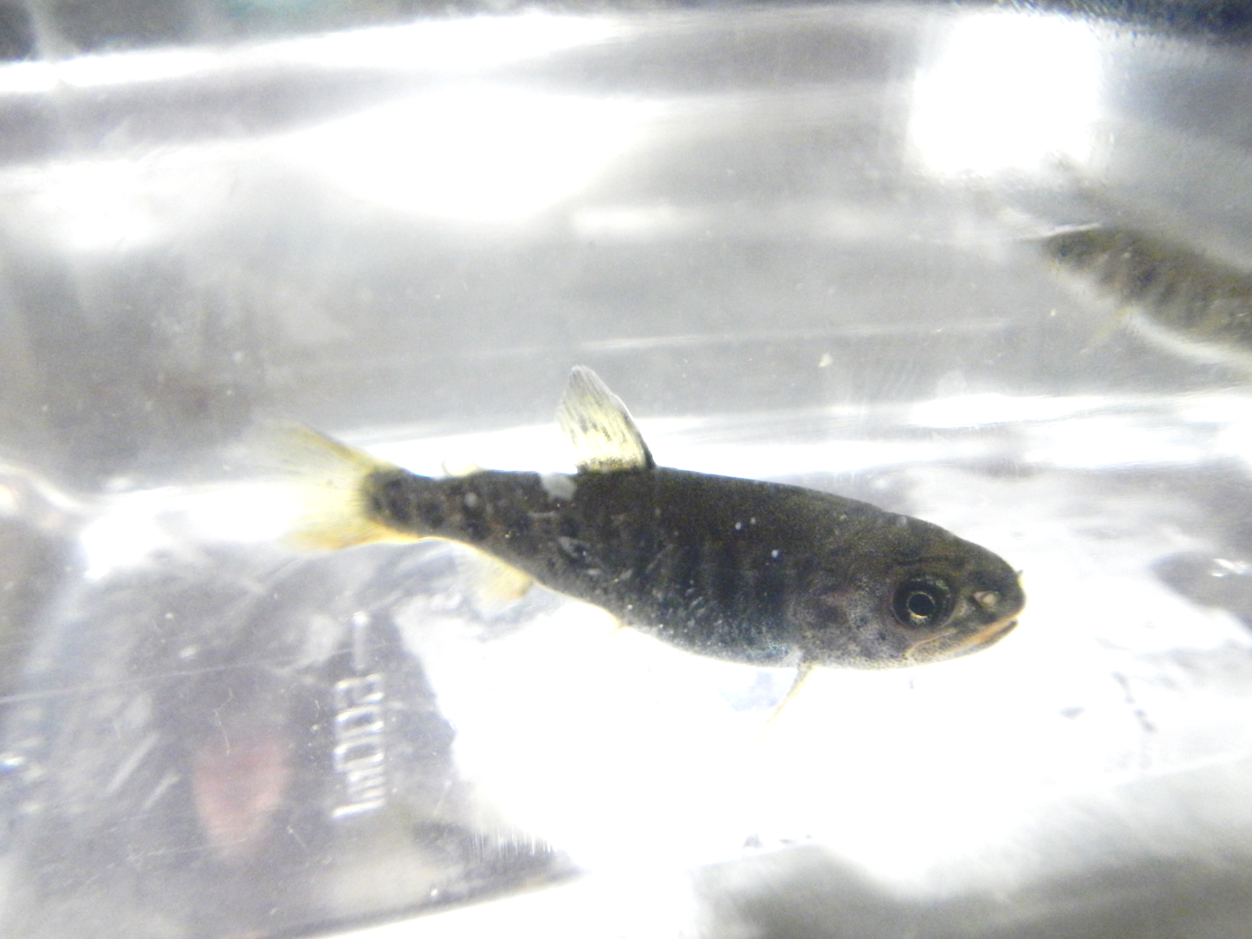
Ichthyophthirius Multifilis

Slide 34
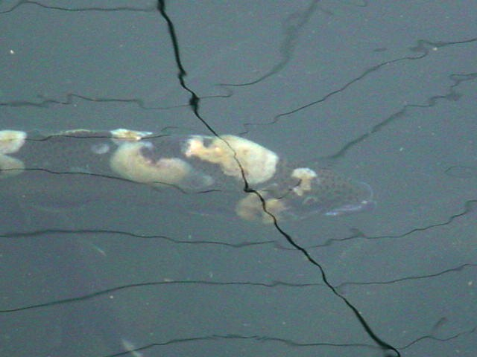
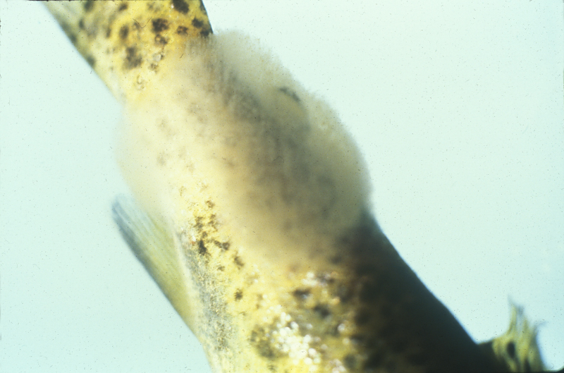
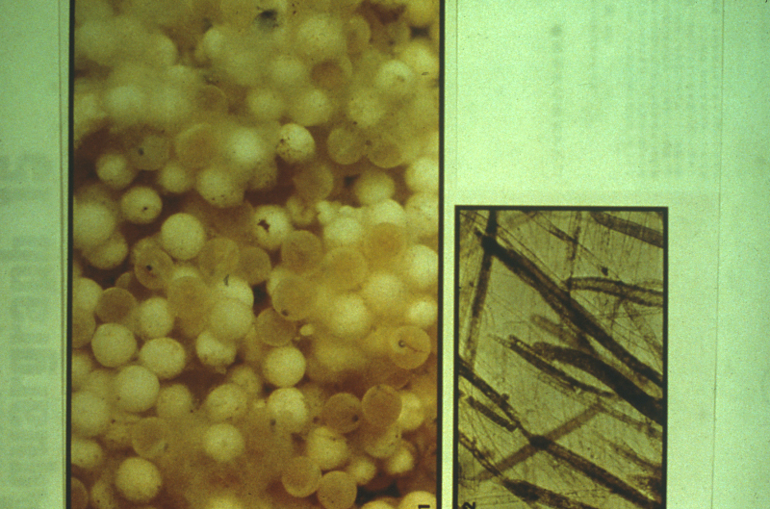
Fungus
Indicator of stressed fish
Indicator of poor environment
Horizontal transmission
Chronic mortality in adults
High mortality in fry and eggs

Slide 35
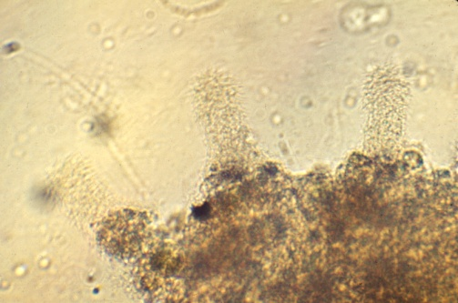
Bacterial Pathogens
Outbreaks usually occur when immune system is compromised
Bacteria have the potential to cause massive mortality events
Can be transmitted both horizontally and vertically
Most can be treated using antibiotics, but they can also develop antibiotic resistance

Slide 36
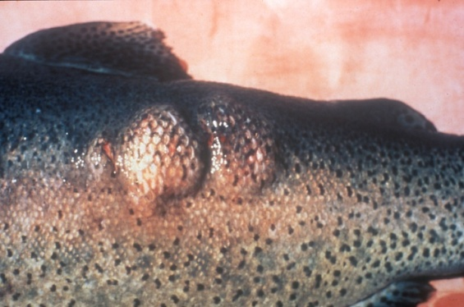
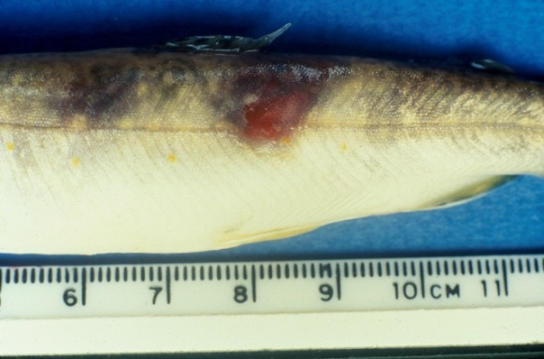
Furunculosis
(Aeromonas salmonicida)
Affects wide range of species
  PFBC facilities primarily brook trout and brown trout
Horizontal and vertical transmission
External signs
  Red lateral lesions or raised areas called furuncles ,lethargy, hemorrhaging at the base of pectoral fins, bloody discharge from vent.

Slide 37
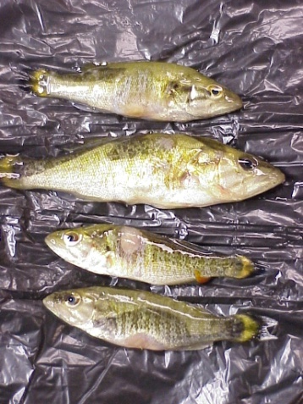
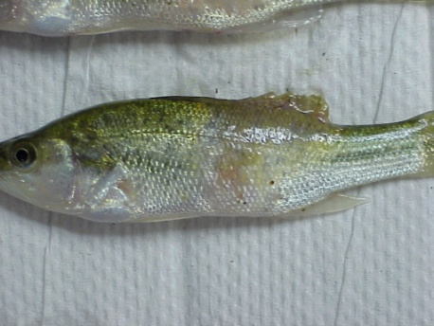
Columnaris disease
(Flavobacterium columnare)
Saddleback disease
Affects all species of fish world wide
Outbreaks occur when water > 60° F
Horizontal transmission
Disease can be external or internal

Slide 38
Viral Pathogens
Very hard to diagnose and to treat
Mortality and outbreaks of disease usually occurs when fish are stressed
Transmitted both vertically and horizontally

Slide 39
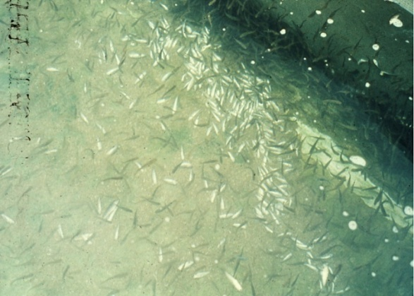
Infectious Pancreatic Necrosis virus (IPNv)
Affects primarily Brook trout
Vertical and horizontal transfer
No treatment available
  Has the potential to cause severe mortality events
Clinical signs include
  Lethargy, longitudinal spiraling, and white mucus cast from vent

Slide 40
Disease Prevention
An ounce of prevention is worth a pound of solution

Slide 41
PFBC Disease Prevention Programs
Pair spawning
  Ensures offspring are not carriers of specific diseases
Egg Disinfection
  Can reduce the transmission of some pathogens from parent to progeny
Vaccination
  Reduces susceptibility of host to disease

Slide 42
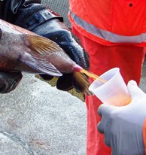
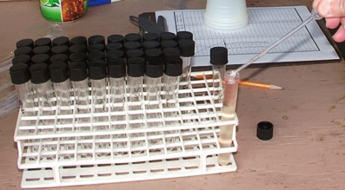
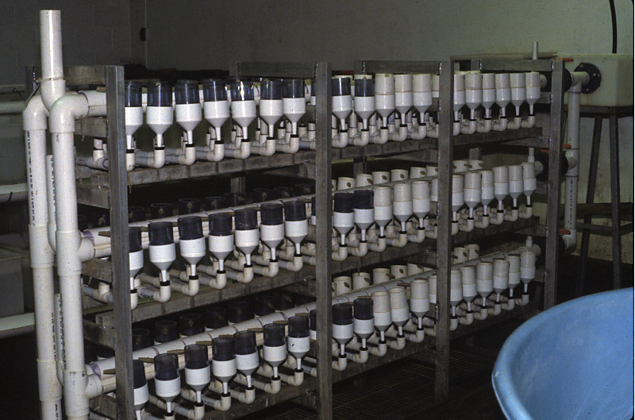
Pair Spawning
Single male and female are spawned and sacrificed
Pair is sampled for pathogens
Eggs from each individual pair are isolated
If parents are positive for disease, the eggs are discarded
Used to create IPNv free Brook trout at the Benner Spring SFH used in the TIC Program.

Slide 43
Egg Disinfection
Iodophor (Iodine) Disinfection of eggs can prevent the vertical transfer of some pathogens to eggs.
Iodophor disinfection is effective in preventing the vertical transmission of Furunculosis
Iodophor Disinfection is not effective in preventing the vertical transmission (IPNv).

Slide 44
What Can TIC Participants do to Prevent Diseases?
Reduce Environmental Stressors
Have a Biosecurity plan in place.

Slide 45
Biosecurity
Strict control over anything that may act as a vector transporting pathogens into your tank
Fish
  Start with disease free fish or fish with a known disease history
  Avoid introducing new fish to your system
Water
  Use chemically treated or UV filtered water
Equipment
  Disinfect all equipment. If there are several tanks use separate equipment for each tank
Staff
  Ensure staff is educated in the Biosecurity protocols

Slide 46
TIC 2012/13 and Ich
Classes needed replacement FISH
Received from Benner Spring SFH (BS)
  TIC Brook Trout (BKT) EGGS are iodophor disinfected, incubated and shipped in UV filtered water and originate from pair spawned brood.
  Replacement FISH are not in UV filtered water, and often overcrowded , BS BKT had experienced several cases of Ich in 2012/13.
After fish replacement fish were received classes started to see severe mortality related to ich.
Fish should have been treated at the hatchery prior to shipment, or before being placed in the TIC tank.

Slide 47
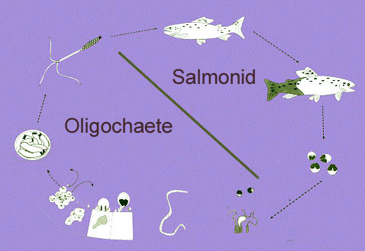
Whirling Disease
Whirling Disease is a Myxozoans parasite that primarily infects Rainbow trout in the first four months of life.
Needs a worm for a host / the worm needs soil to live in.
PFBC eliminated earthen raceways removing the worms habitat thus controlling the disease.
PFBC waits 4 months to move rainbow trout to hatcheries known to have the parasite in the influent water.

Slide 48
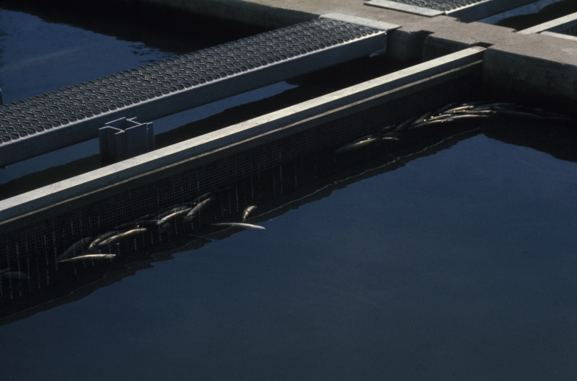
Indicators of Disease

Slide 49
Why is it important to be observant for signs of disease
Severe mortality can be prevented if disease is treated early
Sick fish and dead fish have higher pathogen loads
Disease will often spread through out the tank if not treated
It may take a long time to diagnose the disease
It may not be that difficult to treat (ex Environmental Problems)

Slide 50
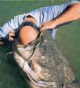
What Might Be Indicators of a Disease?
Mortality
Fish Behavior
Appearance

Slide 51
Indicators of Disease
Fish behavior, appearance, mortality, and growth rate may be species and or environment dependent.
Know what is NORMAL for your fish and environment
Maintaining documentation of NORMAL fish behavior as it relates to the species life stage and environment is crucial in identifying when disease may be present in a population

Slide 52
Mortality
When mortality occurs
  After Feeding - Low Dissolved Oxygen, Bad feed.
  After Cleaning- Low Dissolved Oxygen
  After tank has not been cleaned for several days
What size fish
  Only larger fish -Sign of low dissolved oxygen.
  Only smaller fish – Possibly Parasites
Appearance of dead fish
  Flared Gills / arched back – Dissolved oxygen
  Covered in Fungus
Rate of mortality can be an indicator of pathogen type or environmental condition.

Slide 53
Rate of Mortality
Class I mortality curve
  Rapid increase < 2 days, acute environmental condition or a virulent pathogen
Class II mortality curve
  Moderate increase over several days, virus, bacteria, or low level environmental stress
Class III mortality curve
  Slow increase over a prolonged period, Low virulence bacteria, parasites, or a chronic environmental condition
I
Mortality
II
III
Days

Slide 54
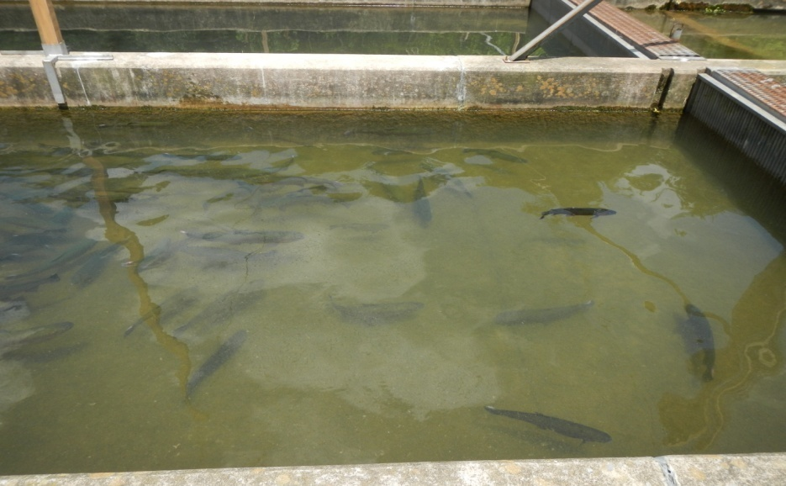
Fish Behavior
Fish behavior can often indicate that a fish or group of fish is sick, and in some situations indicate what disease is affecting them
A specific behavior can be an indicator for multiple diseases or environmental conditions

Slide 55
Fish Behavior
Loss of appetite
Position in the water column/tank, Fish should be spread out in tank.
Labored breathing
Lethargy or listlessness
Flashing, Longitudinal spiraling, spinning in circles, Rubbing on the bottom.

Slide 56
Fish Behavior
Loss of appetite
  Gill Parasites or organic material on the gills
  Bad feed/Nutritional
Position in the Tank
  surface – Low DO, Gill Parasites
  At the influent – Low DO, Temperature, Gill Parasites
Lethargy or listlessness
  Bacterial disease, virus, Nutritional.

Slide 57
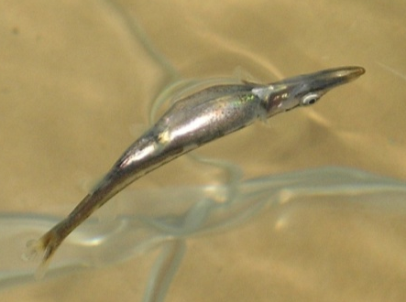
Fish Behavior
Flashing or Rubbing on the bottom
  Parasites
Spinning in circles
  Neurological damage
  Whirling disease, bacterial pathogens, impact
Inverted swimming (Bloated)
  Swim bladder, or nutritional issues.

Slide 58
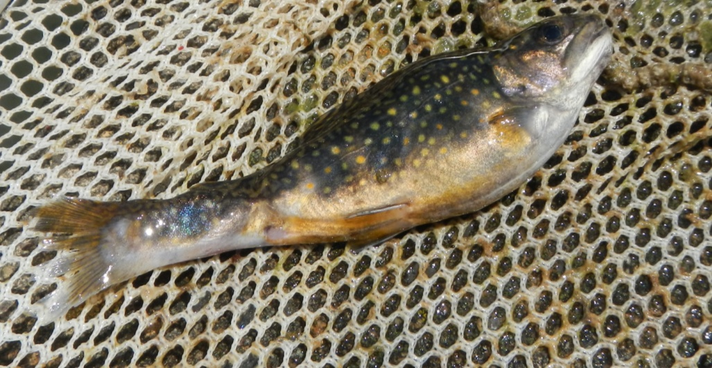
Fish Appearance
Disease diagnosis should not be made on appearance alone, often clinical signs are very similar or the same for multiple disease
It is important to know what is NORMAL for your fish

Slide 59
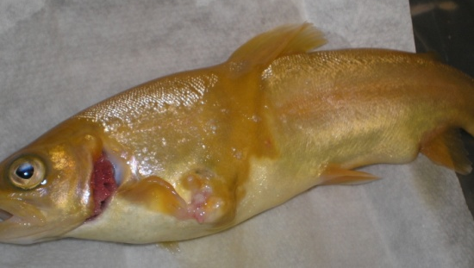
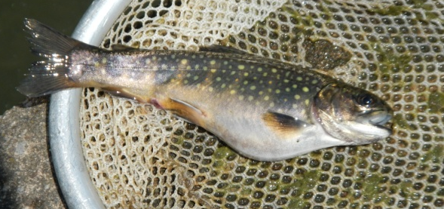
Fish Appearance
Coloration
Condition of the eyes
Condition of the fins
Condition of the gills
Presence of lesions/growths/
Hemorrhaging
Discharge from the vent
Deformities

Slide 60
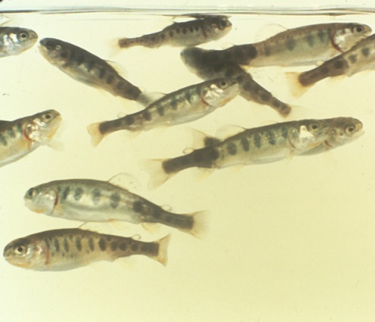
Fish Appearance
Color
Light, Dark, Molted
Fish will often change color when sick or stressed.
Color change is sometimes a sign of a specific disease or condition
  Whirling disease=Black tail
  Dark Spots = Neurological damage
  Dark Spots = Blunt force trauma
  Nutritional
  Bacterial disease
  Viral disease

Slide 61
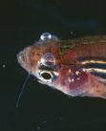
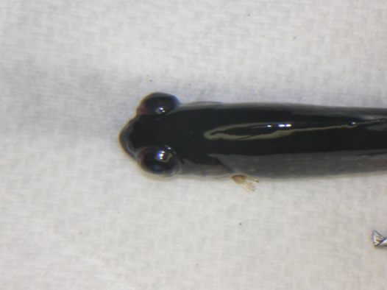
Fish Appearance
Eye Condition
Exophthalmia (Pop-eye)
  Gas bubble disease
  Systemic bacterial/viral infection
Cataracts
  Nutritional
  Genetic
Missing
  Parasites
  Gas bubble disease
  Over crowding

Slide 62
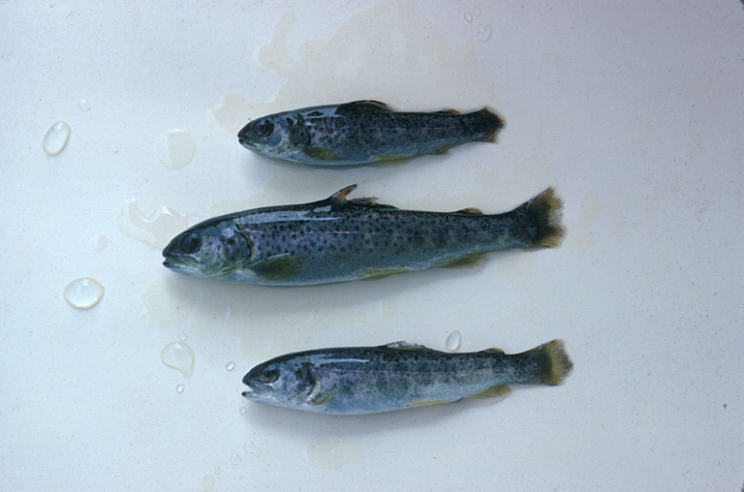
Fish Appearance
Fin Condition
Eroded, frayed, missing, gas bubbles
  Bacterial
  Fungus
  Environmental
    Fish density, Gas bubble disease
Hemorrhaging at the base of fins
  Bacterial or viral infection

Slide 63
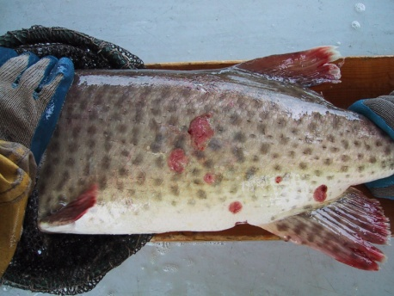


Fish Appearance
Presence of lesions/growths
Size, shape, color often indications of specific bacterial infections
Fish predators
Lesions can also be linked to nutritional and environmental problems

Slide 64
Fish Appearance
Discharge from vent
Fish will have different color discharges depending on disease
Yellow - Columnaris (Bacterial)
Red - Furunculosis, hexamita infestation
White –IPNv (Viral) or Nutritional.
Hemorrhaging around the vent
  Bacterial or parasitic infection

Slide 65


Fish Appearance
Gill Color/condition -Gill color can be a sign of systemic infection or external infestation
  Light colored gills indicate anemia, and bacterial infection
  Hemorrhaging can indicate environmental problem or parasites
  Blotches can indicate environmental or bacterial gill disease
  Gills will lose color after death;
  examine live fish

Slide 66
What to do if you observe signs of disease?
Act now!!
Reduce Stress
  Ensure the water flow, oxygen, nitrogen, and water temperature are at acceptable levels
Document conditions and results

Slide 67
Disease Treatment
Chemical treatment is sometimes necessary but should be the last option.

Slide 68
Treating disease
Usually the simplest thing
Try to reduce environmental stressors first
Remember fish need FOOD, O2, Water to survive
Determine what changed prior to mortality (document daily activities)
  lapses in biosecurity
  New stressors

Slide 69
Summary
Fish Mortality is usually the result of a combination of factors creating the “perfect storm”
Good biosecurity is essential in preventing disease
Documentation of environmental and fish condition is key to diagnosing disease
Know what is normal for your fish.

